Slide 1
Operating Systems and Embedded System Design
Introduction and Course Overview
Structure and functionality of operating system/Real-time Operating system.
Algorithms in process and resource management
Embedded System design involving both hardware and software architectures.
Communication Protocols used in Embedded System

Slide 2
Operating Systems and Embedded System Design
Recommended Text Books

Slide 3
Operating Systems and Embedded System Design
Recommended Text Books

Slide 4
Operating Systems and Embedded System Design
Recommended Text Books

Slide 5
Chapter 1: Introduction
What Operating Systems Do
Goals of an operating system
Operation of an os
Resource allocation and related functions.
Classes of an operating system.
Operating System Services .
System Calls and Types.
Operating system Structure – Simple , Layered, Microkernels, Modules and Hybrid systems.

Slide 6
Unit I: General Purpose Operating Systems
What is an Operating System?
Why are Operating Systems needed?
How are Operating Systems designed and implemented?

Slide 7
Chapter 1: Introduction

Slide 8
What is an Operating System?
A program that acts as an intermediary between a user of a computer and the computer hardware
A special piece of software that….
—Abstracts and
—Arbitrates computer resources
Operating system goals:
Execute user programs and make solving user problems easier
Make the computer system convenient to use
Use the computer hardware in an efficient manner

Slide 9
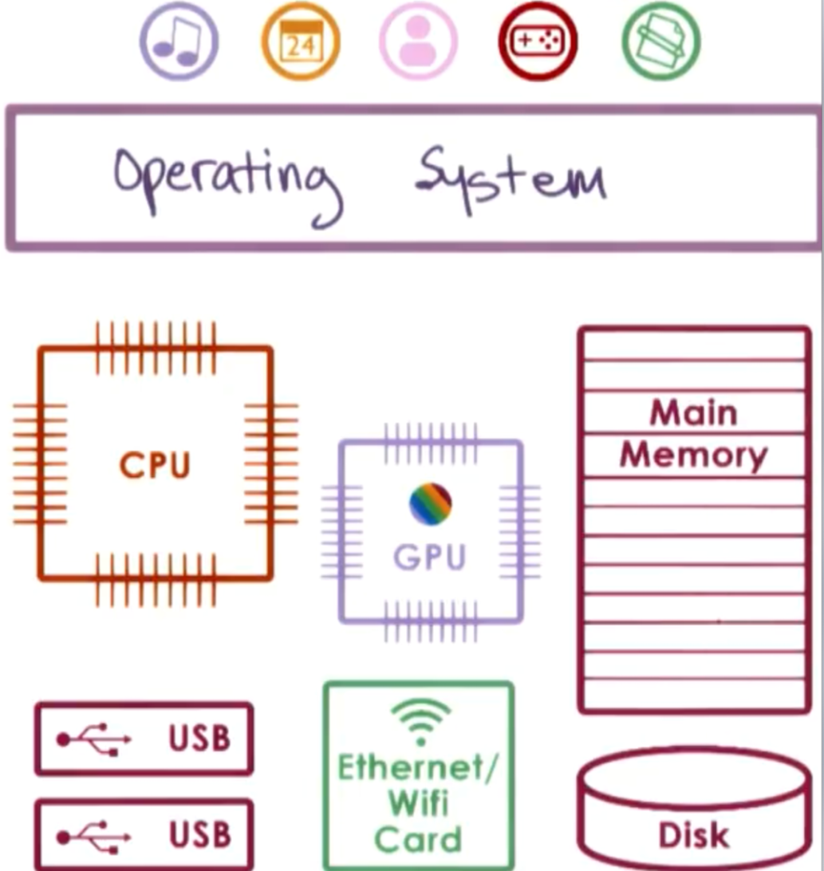
Computer System Structure

Slide 10
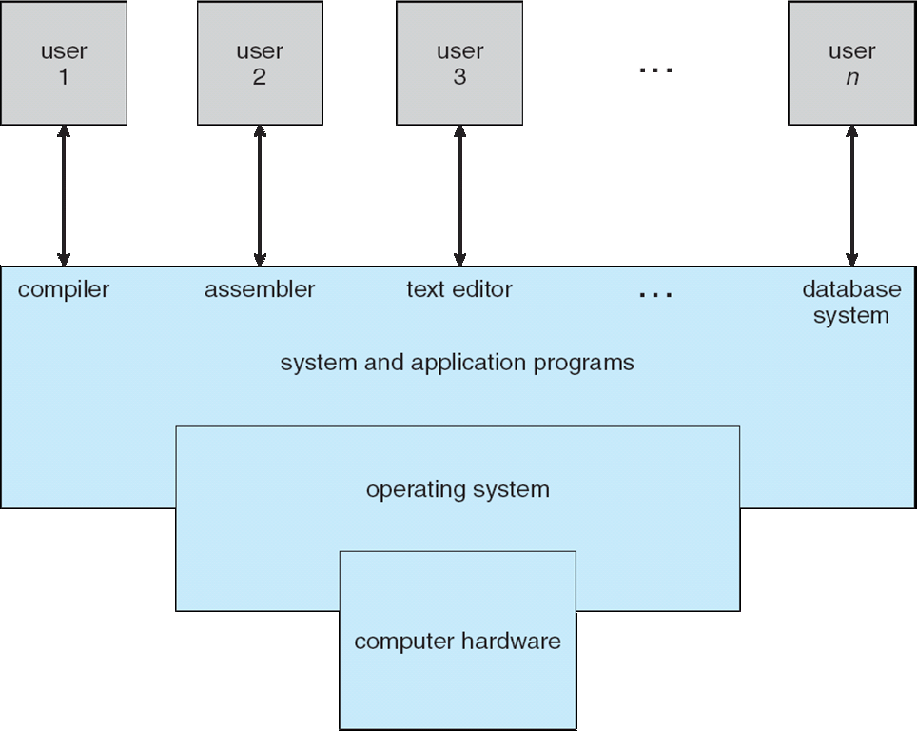
Four Components of a Computer System

Slide 11
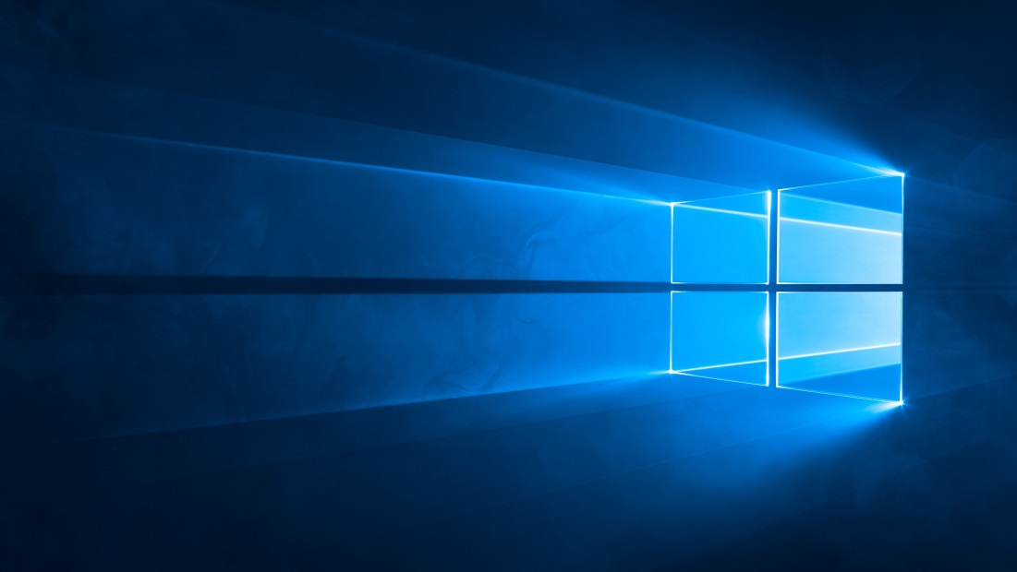
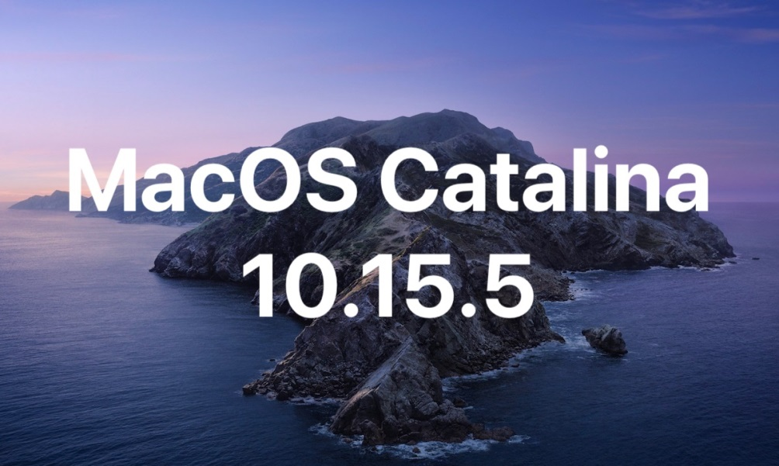
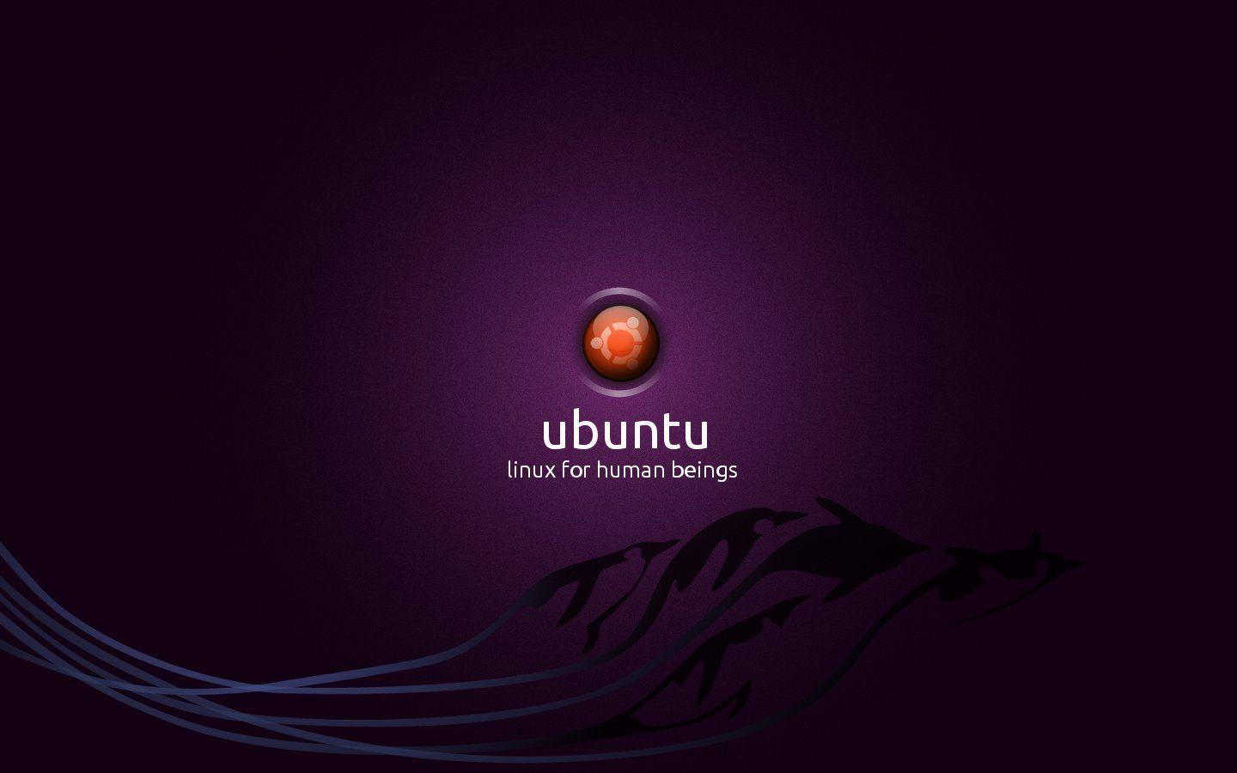

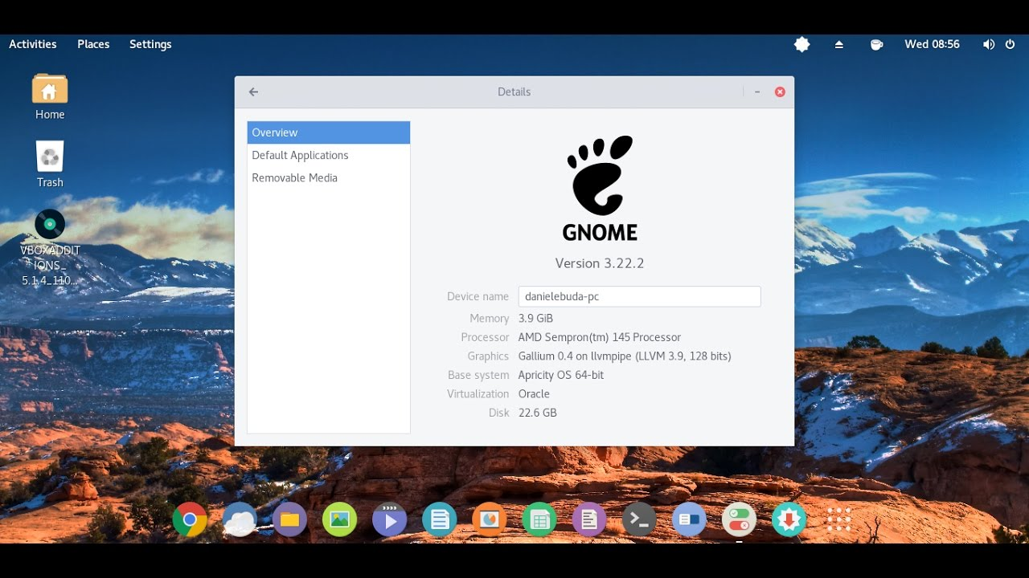
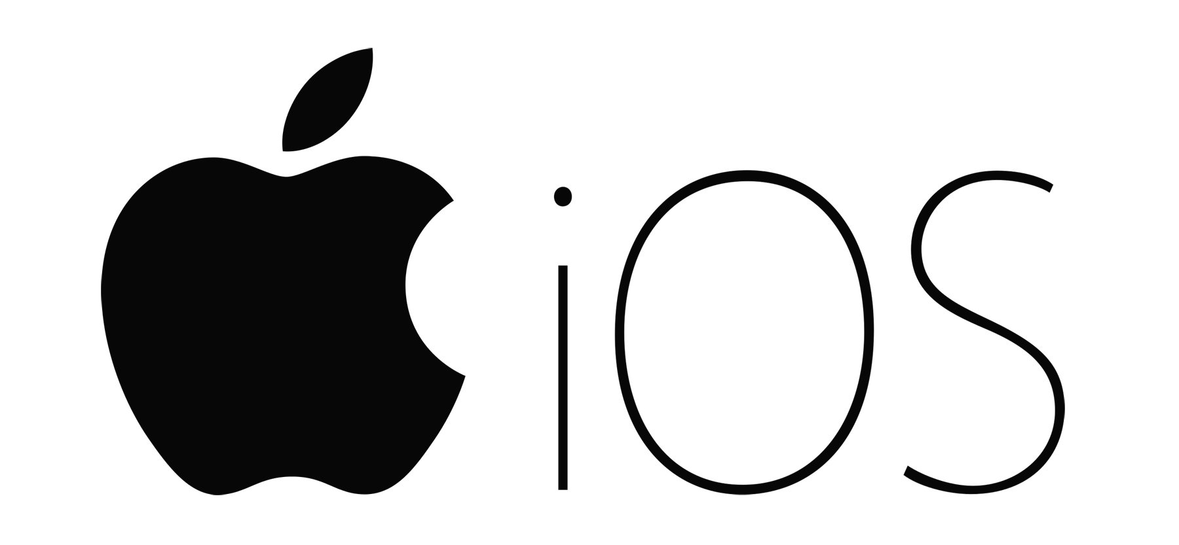
Operating System Examples
11

Slide 12
Operating System Examples
Application Specific
– Embedded OS • eg. Contiki OS, for extremely memory constraint environments
– Mobile OS • Android, iOS, Ubuntu Touch, Windows Touch
– RTOS • QNX, VxWorks, RTLinux
– For Servers • Redhat, Ubuntu, Windows Server
– Desktops • Mac OS, Windows, Ubuntu

Slide 13
What Operating Systems Do
Depends on the point of view
Users want convenience, ease of use and good performance
Don’t care about resource utilization
But shared computer such as mainframe or minicomputer must keep all users happy
Operating system is a resource allocator and control program making efficient use of HW and managing execution of user programs
Users of dedicate systems such as workstations have dedicated resources but frequently use shared resources from servers
Mobile devices like smartphones and tables are resource poor, optimized for usability and battery life
Mobile user interfaces such as touch screens, voice recognition
Some computers have little or no user interface, such as embedded computers in devices and automobiles
Run primarily without user intervention

Slide 14
Operating System Definition
OS is a resource allocator
Manages all resources
Decides between conflicting requests for efficient and fair resource use
OS is a control program
Controls execution of programs to prevent errors and improper use of the computer

Slide 15
Operating System Definition (Cont.)
No universally accepted definition
“Everything a vendor ships when you order an operating system” is a good approximation
But varies wildly
“The one program running at all times on the computer” is the kernel.
Everything else is either
a system program (ships with the operating system) , or
an application program.

Slide 16
Linux-based System Components
Application
Root File System
Bootloader
Software executed at power-up to set-up the hardware to run the operating system
Device tree
A tree data structure with nodes that describe the physical devices in the hardware needed by the Linux kernel to initialize properly the device drivers
Linux Kernel
The operating system code providing all the services to manage the hardware resources
System Programs
System Call Interface
Process Management
Virtual File System
Linux kernel
Memory Management
Network Management
Device Drivers
Device tree
Bootloader
Hardware
Notes:
A typical Linux-based embedded system is made up of numerous components. One of these components is the bootloader. This is a piece of software that is executed at power-up and sets up the hardware to run the operating system.
Another component is the device tree. This is a tree data structure with nodes that describe the physical devices in the hardware needed by the Linux kernel to initialize the device drivers.
Also, potentially the main component is the Linux kernel. This is essentially the operating system code and provides all of the services to manage hardware resources and many other tasks.

Slide 17
Linux-based System Components
Application
Root File System
System programs
User-friendly utilities to access operating system services
Application
Software implementing the functionalities to be delivered to the embedded system user
Root filesystem
Container for the Linux Kernel configuration files, the system programs, and the application
System Programs
System Call Interface
Process Management
Virtual File System
Linux Kernel
Memory Management
Network Management
Device Drivers
Device tree
Bootloader
Hardware
Notes:
System programs are user-friendly utilities that implement and provide access to deeper-lying operating system services.
The applications are software that implement the functionality that the system is required to provide to the user.
The root file system is the container of the Linux kernel configuration files, system programs, and the applications.

Slide 18
Computer Startup
bootstrap program is loaded at power-up or reboot
Typically stored in ROM or EPROM, generally known as firmware
Initializes all aspects of system
Loads operating system kernel and starts execution

Slide 19
The Role of the Bootloader
When powered-up, the processor needs a simple way to get the information it needs.
Where the software is located
How to get access to the software location
Where the stack is located
At power-up, the program counter is set to a default known value, the reset vector.
The software starting at the reset vector, which will load the bootloader, which takes care of providing the processor all the needed information.
The operations performed depend on the system architecture.
Notes:
When a system is powered-up, a program counter is set to a default known value, which is the reset vector.
A program counter is a register that holds the address of the instruction that is next to be run.
The reset vector is a pointer to an address that contains the first instruction to be executed for the firmware.
The bootloader is the first thing to be run and will take care of providing the processer with all the information it needs, such as startup software location, how to access it, and where the stack is located.
The specific operations performed in the bootloader are dependent on the system’s architecture.

Slide 20
Possible Scenarios
Microcontroller (MCU)
RAM
Memory
CPU
Scenario 1, typical of microcontrollers
All the sw (bootloader + device tree + operating system + root filesystem) is stored in persistent storage (boot flash) embedded in the microcontroller.
All the sw is executed from the persistent storage.
The CPU reset vector is located in the boot flash.
The RAM Memory is embedded in the microcontroller and is used for data, stack and heap only.
Boot Flash
I/O
Data
Stack
Heap
Application
System Programs
Root File System
Operating System
Device tree
Bootloader
Notes:
Looking back to the two different implementations of the reference hardware model, we can see how the bootloader is used differently.
For the microcontroller-based implementation, all of the software is stored in a form of persistent storage that is embedded into the microcontroller. This software is executed from the persistent storage.
The CPU reset vector that points to the bootloader is located in the boot flash.
Finally, the RAM is also embedded into the microcontroller and is exclusively used for data, the stack, and the heap.

Slide 21
Possible Scenarios
System-on-Chip
Scenario 2, typical of System-on-Chip
The bootloader is stored into the boot flash.
The CPU reset vector is located in the boot flash.
The root filesystem, operating systems, and device tree are stored in the mass memory flash and loaded in RAM memory by the bootloader.
The RAM memory is external to the SoC. It will store the operating system + application software, root filesystem (if configured as RAM disk), data, stack, and heap.
RAM
Memory
CPU
Mass Memory
Flash
I/O
Boot Flash
Data
Stack
Heap
Bootloader
Application
System Programs
Operating System
Device tree
Notes:
For the system-on-chip based implementation of the reference hardware model, it is arranged differently.
The bootloader is still stored in boot flash, similar to the microcontroller implementation, as well as the CPU reset vector.
But unlike the microcontroller, the software such as applications, system programs, operating system, and device tree are stored on the mass memory flash but are loaded onto RAM by the bootloader.
Finally, the RAM is external to the system-on-chip and it will store what was loaded onto it by the bootloader, as well as data, the stack, and the heap.

Slide 22
An Example of Bootloader Operations
RAM
Memory
0x0003_FFFF
Let’s consider Scenario 2 for a given SoC with the following memory map:
RAM memory 512 kbytes (arranged as 128 kwords, each 32 bytes long), from 0x0002_0000 to 0x0003_FFFF
Mass memory flash 256 kbytes (same organization as before), from 0x0001_0000 to 0x0001_FFFF
Boot flash 256 kbytes (same organization as before), from 0x000_0000 to 0x0000_FFFF
Mass Memory
Flash
0x0001_FFFF
Boot Flash
0x0000_FFFF
CPU reset vector
0x0000_0000
Notes:
Let’s look at an example of the bootloader’s operations for the system-on-chip implementation.
The memory map for this scenario will look like this.
The RAM will be 512 kilobytes and will be assigned the addresses 0x0002_0000 to 0x0003_FFFF.
The mass memory flash will be 256 kilobytes and will be assigned the addresses 0x0001_0000 to 0x0001_FFFF.
Then finally, the boot flash will also be 256 kilobytes and will be assigned the addresses 0x000_0000 to 0x0000_FFFF.

Slide 23
An Example of Bootloader Operations
RAM
Memory
0x0003_FFFF
Time = before power up
The boot flash is preloaded with the bootloader
First bootloader instruction at 0x0000_0FFF
Last bootloader instruction at 0x0000_AFFF
The mass memory flash is preloaded with:
Device tree (DT)
Operating systems (OS)
System programs (SP)
Application
Mass Memory
Flash
0x0001_FFFF
Application
SP
OS
DT
Boot Flash
0x0000_FFFF
0x0000_AFFF
Bootloader
b 0x0000_0FFF
CPU reset vector
0x0000_0000
0x0000_0000
Notes:
This is the state of the memory map before power up.
The boot flash address range is preloaded with the bootloader. In this diagram, the first bootloader instruction will be positioned at 0x0000_0FFF while the final instruction will be at 0x0000_AFFF.
The mass memory flash address range will be preloaded with the components such as the device tree, the operating system, the systems programs, and the applications.

Slide 24
An Example of Bootloader Operations
RAM
Memory
0x0003_FFFF
Time = power up
The CPU starts executing software from the reset vector:
It jumps to the first instruction of the bootloader.
It runs the bootloader software from booth flash memory.
Mass Memory
Flash
0x0001_FFFF
Application
SP
OS
DT
Boot Flash
0x0000_FFFF
0x0000_AFFF
Bootloader
b 0x0000_0FFF
CPU reset vector
0x0000_0000
0x0000_0000
Notes:
This is the state of the memory map during power up.
At this point, the CPU will start executing processes using the reset vector. It will initially jump to the first instruction of the bootloader and then run the bootloader software from boot flash memory.

Slide 25
An Example of Bootloader Operations
RAM
Memory
0x0003_FFFF
Time = during bootstrap
The CPU executes bootloader software that:
Initializes the CPU RAM memory controller
Sets up the CPU registers for mapping stack and heap to RAM memory
Copies device tree, operating system, system programs, and applications to RAM memory
Mass Memory
Flash
0x0001_FFFF
Application
SP
OS
DT
Boot Flash
0x0000_FFFF
0x0000_AFFF
Bootloader
b 0x0000_0FFF
CPU reset vector
0x0000_0000
0x0000_0000
Notes:
The next state is during the bootstrap process. In this phase, the CPU RAM controller will be initialized. Also, the CPU registers for mapping the stack and heap to RAM will be set up.
Finally, the device tree, operating system, system programs, and applications will be copied across to RAM.

Slide 26
An Example of Bootloader Operations
Stack
Heap
RAM
Memory
0x0003_FFFF
Time = end of bootstrap
The bootloader jumps to the first instruction of the operating system.
The CPU now executes the operating system software, which is responsible for:
Setting-up the execution environment for the application
Starting application execution
Application
SP
OS
DT
Mass Memory
Flash
0x0001_FFFF
Application
SP
OS
DT
Boot Flash
0x0000_FFFF
0x0000_AFFF
Bootloader
b 0x0000_0FFF
CPU reset vector
0x0000_0000
0x0000_0000
Notes:
The final stage we will look at is the end of the bootstrap, in which the bootloader jumps to the first instruction of the operating system.
The CPU then executes the operating system software, which is responsible for setting up the execution environment for applications and the starting application execution.

Slide 27
Kernel
The Kernel is the software responsible for optimally managing the embedded system’s hardware resources.
It offers services such as:
Process management
Process scheduling
Inter-process communication
Memory management
I/O management (device drivers)
File system
Networking
And more
System Call Interface
Process Management
Virtual File System
Kernel
Memory Management
Network Management
Device Drivers
Notes:
The Linux kernel is the software or operating system kernel that is responsible for optimally managing the embedded system’s hardware resources.
It offers a range of services that perform a variety of essential functions for an operating system. This includes process management and scheduling via mechanisms such as task schedulers. This is primarily to do with how the CPU allocates its resources to different processes that require execution concurrently, and how they are scheduled to prevent any conflicts or interrupts within the system.
It also offers the ability for processes to communicate with each other and to share data via inter-process communication. This can be achieved in a variety of ways. One method is via sockets, which send data via a network interface to another process. Another method is shared memory, in which multiple processes have access to the same block of memory. The processes can then alter this block and share information.
Memory and I/O management are also included. We briefly looked at memory management in earlier slides, at how devices are allotted address ranges in memory. I/O management is supported via device drivers, allowing the user to control or interact with external devices that are attached to the system.
There is also support for a range of file system types that detail the structure of how information is stored, laid out, and accessed on the system.
Additionally, there is support for network management such as network protocols and network device drivers. Users have the ability to configure network settings and enable them to interact with networks.

Slide 28
Linux Kernel
The Linux kernel adopts a layered operating system architecture:
The operating system is divided into two layers, one (user space) built on top of the other (Kernel space).
User space and Kernel space are different address spaces.
Basic services are delivered by a single executable, monolithic Kernel.
Services can be extended at run-time through loadable Kernel modules
Application
User Space
System Programs
System Call Interface
Process Management
Virtual File System
Kernel Space
Memory Management
Network Management
Device Drivers
Loadable Module
Monolithic kernel
Notes:
The Linux kernel takes advantage of a layered operating system architecture. This leads to the operating system being divided into two main layers. One layer is user space; this layer is typically the higher-level parts of the system and mainly consists of applications or system programs, essentially, code that does not run on the operating system’s kernel. This is built on top of the kernel space layer. This is where the kernel operates, executing services for the system. These two layers have different address spaces.
Basic services are delivered by one single executable. This is in line with monolithic kernels, where the entire operating system works in kernel space.
These services can be extended or added to at run-time by using loadable kernel modules.

Slide 29
Linux Kernel
Advantage
Good separation between application/system programs and kernel. Bugs in the user space do not corrupt the kernel.
Disadvantages
Bugs in one Kernel component (e.g. a new device driver) can crash the whole system.
Application
User Space
System Programs
System Call Interface
Process Management
Virtual File System
Kernel Space
Memory Management
Network Management
Device Drivers
Loadable Module
Monolithic kernel
Notes:
One advantage to the Linux kernel layout is it provides good separation between applications or system programs and the kernel. This means that any bugs that occur in user space will not affect or corrupt the kernel.
However, the disadvantage to it is that if there is a bug in one kernel component, which could be a new device driver, it has the potential to crash the whole system.

Slide 30
Process Management
A process is a program in execution. It is a unit of work within the system. Program is a passive entity, process is an active entity.
Process needs resources to accomplish its task
CPU, memory, I/O, files
Initialization data
Process termination requires reclaim of any reusable resources
Single-threaded process has one program counter specifying location of next instruction to execute
Process executes instructions sequentially, one at a time, until completion
Multi-threaded process has one program counter per thread
Typically system has many processes, some user, some operating system running concurrently on one or more CPUs
Concurrency by multiplexing the CPUs among the processes / threads

Slide 31
Process Management Activities
The operating system is responsible for the following activities in connection with process management:
Creating and deleting both user and system processes
Suspending and resuming processes
Providing mechanisms for process synchronization
Providing mechanisms for process communication
Providing mechanisms for deadlock handling

Slide 32
Memory Management
To execute a program all (or part) of the instructions must be in memory
All (or part) of the data that is needed by the program must be in memory.
Memory management determines what is in memory and when
Optimizing CPU utilization and computer response to users
Memory management activities
Keeping track of which parts of memory are currently being used and by whom
Deciding which processes (or parts thereof) and data to move into and out of memory
Allocating and deallocating memory space as needed

Slide 33
Storage Management
OS provides a uniform, logical view of information storage
Abstracts physical properties to logical storage unit - file
Each medium is controlled by device (i.e., disk drive, tape drive)
Varying properties include access speed, capacity, data-transfer rate, access method (sequential or random)
File-System management
Files usually organized into directories
Access control on most systems to determine who can access what
OS activities include
Creating and deleting files and directories
Primitives to manipulate files and directories
Mapping files onto secondary storage
Backup files onto stable (non-volatile) storage media

Slide 34
Mass-Storage Management
Usually disks used to store data that does not fit in main memory or data that must be kept for a “long” period of time
Proper management is of central importance
Entire speed of computer operation hinges on disk subsystem and its algorithms
OS activities
Free-space management
Storage allocation
Disk scheduling
Some storage need not be fast
Tertiary storage includes optical storage, magnetic tape
Still must be managed – by OS or applications
Varies between WORM (write-once, read-many-times) and RW (read-write)

Slide 35
End of Introduction to OS

Slide 36
Operating-System Services and Structures

Slide 37
Operating System Services
Operating systems provide an environment for execution of programs and services to programs and users
One set of operating-system services provides functions that are helpful to the user:
User interface - Almost all operating systems have a user interface (UI).
Varies between Command-Line (CLI), Graphics User Interface (GUI), Batch
Program execution - The system must be able to load a program into memory and to run that program, end execution, either normally or abnormally (indicating error)
I/O operations - A running program may require I/O, which may involve a file or an I/O device

Slide 38
Operating System Services (Cont.)
One set of operating-system services provides functions that are helpful to the user (Cont.):
File-system manipulation - The file system is of particular interest. Programs need to read and write files and directories, create and delete them, search them, list file Information, permission management.
Communications – Processes may exchange information, on the same computer or between computers over a network
Communications may be via shared memory or through message passing (packets moved by the OS)
Error detection – OS needs to be constantly aware of possible errors
May occur in the CPU and memory hardware, in I/O devices, in user program
For each type of error, OS should take the appropriate action to ensure correct and consistent computing
Debugging facilities can greatly enhance the user’s and programmer’s abilities to efficiently use the system

Slide 39
Operating System Services (Cont.)
Another set of OS functions exists for ensuring the efficient operation of the system itself via resource sharing
Resource allocation - When multiple users or multiple jobs running concurrently, resources must be allocated to each of them
Many types of resources - CPU cycles, main memory, file storage, I/O devices.
Accounting - To keep track of which users use how much and what kinds of computer resources
Protection and security - The owners of information stored in a multiuser or networked computer system may want to control use of that information, concurrent processes should not interfere with each other
Protection involves ensuring that all access to system resources is controlled
Security of the system from outsiders requires user authentication, extends to defending external I/O devices from invalid access attempts

Slide 40
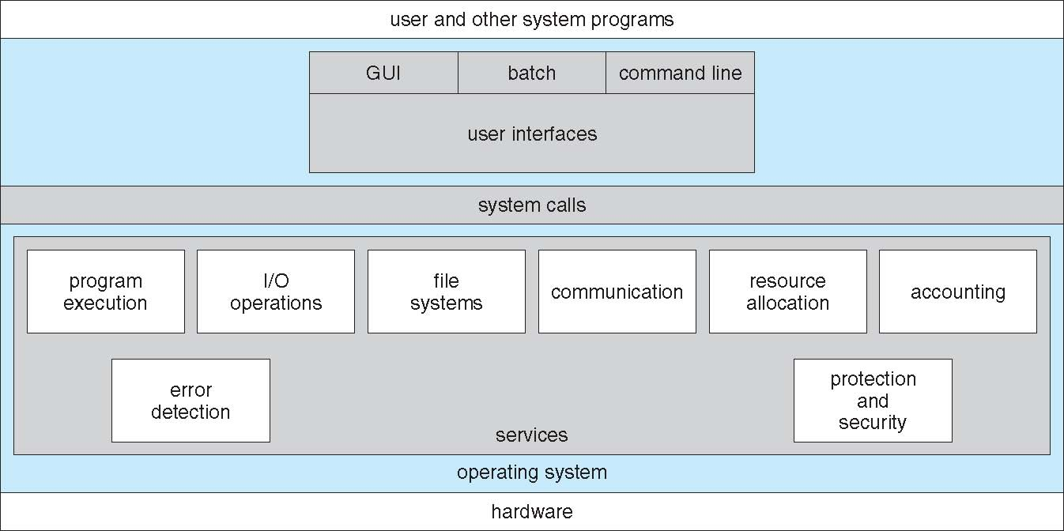
A View of Operating System Services

Slide 41
System Calls
Programming interface to the services provided by the OS
Typically written in a high-level language (C or C++)
Mostly accessed by programs via a high-level Application Programming Interface (API) rather than direct system call use
Three most common APIs are Win32 API for Windows, POSIX API for POSIX-based systems (including virtually all versions of UNIX, Linux, and Mac OS X), and Java API for the Java virtual machine (JVM)
The Portable Operating System Interface (POSIX) is a family of standards specified by the IEEE Computer Society for maintaining compatibility between operating systems.

Slide 42
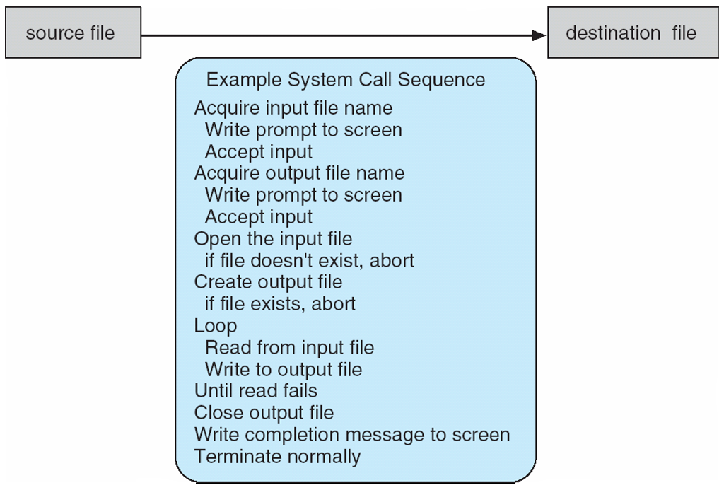
Example of System Calls
System call sequence to copy the contents of one file to another file

Slide 43
System Call Implementation
Typically, a number associated with each system call
System-call interface maintains a table indexed according to these numbers
The system call interface invokes the intended system call in OS kernel and returns status of the system call and any return values
The caller need know nothing about how the system call is implemented
Just needs to obey API and understand what OS will do as a result call
Most details of OS interface hidden from programmer by API
Managed by run-time support library (set of functions built into libraries included with compiler)

Slide 44
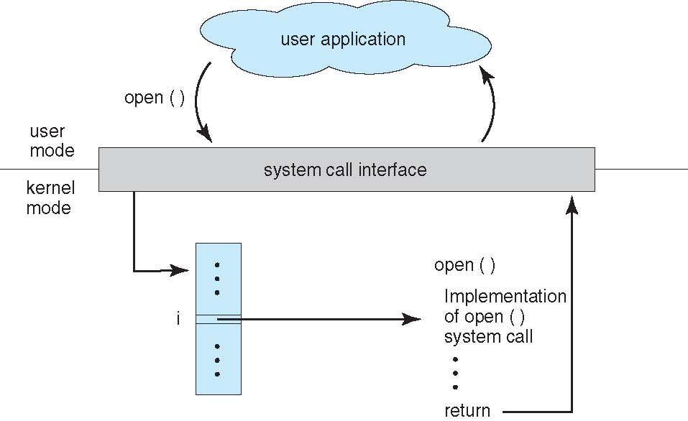
API – System Call – OS Relationship

Slide 45
Types of System Calls
Process control
create process, terminate process
end, abort
load, execute
get process attributes, set process attributes
wait for time
wait event, signal event
allocate and free memory
Dump memory if error
Debugger for determining bugs, single step execution
Locks for managing access to shared data between processes

Slide 46
Types of System Calls
File management
create file, delete file
open, close file
read, write, reposition
get and set file attributes
Device management
request device, release device
read, write, reposition
get device attributes, set device attributes
logically attach or detach devices

Slide 47
Types of System Calls (Cont.)
Information maintenance
get time or date, set time or date
get system data, set system data
get and set process, file, or device attributes
Communications
create, delete communication connection
send, receive messages if message passing model to host name or process name
From client to server
Shared-memory model create and gain access to memory regions
transfer status information
attach and detach remote devices

Slide 48
Types of System Calls (Cont.)
Protection
Control access to resources
Get and set permissions
Allow and deny user access

Slide 49
Operating System Structure
General-purpose OS is very large program
Various ways to structure ones
Simple structure – MS-DOS
More complex -- UNIX
Layered – an abstrcation
Microkernel -Mach

Slide 50
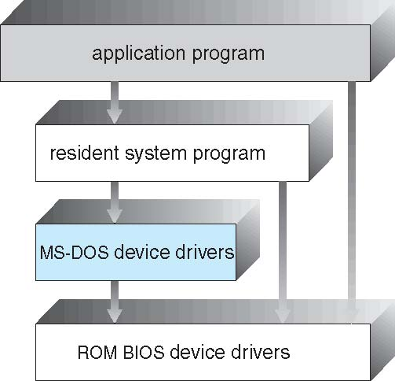
Simple Structure -- MS-DOS
MS-DOS – written to provide the most functionality in the least space
Not divided into modules
Although MS-DOS has some structure, its interfaces and levels of functionality are not well separated

Slide 51
Non Simple Structure -- UNIX
UNIX – limited by hardware functionality, the original UNIX operating system had limited structuring. The UNIX OS consists of two separable parts
Systems programs
The kernel
Consists of everything below the system-call interface and above the physical hardware
Provides the file system, CPU scheduling, memory management, and other operating-system functions; a large number of functions for one level

Slide 52
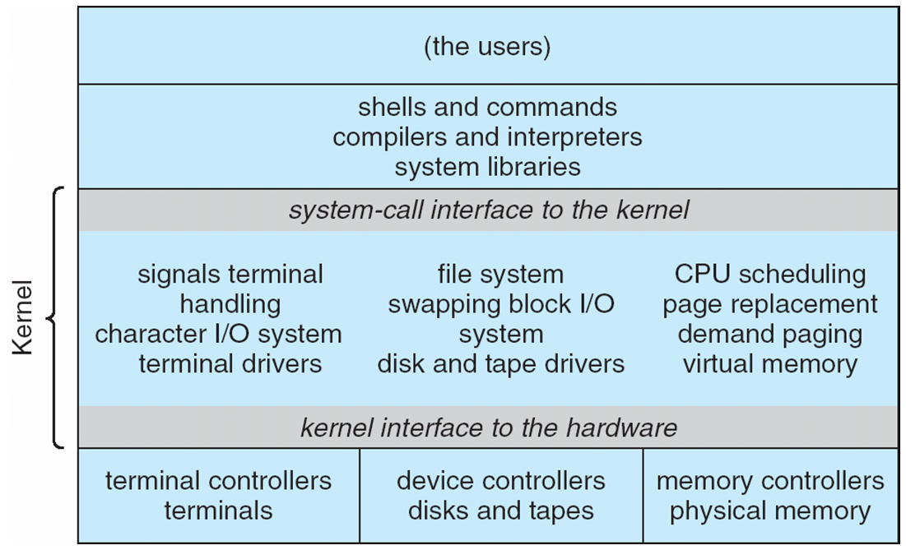
Traditional UNIX System Structure
Beyond simple but not fully layered

Slide 53
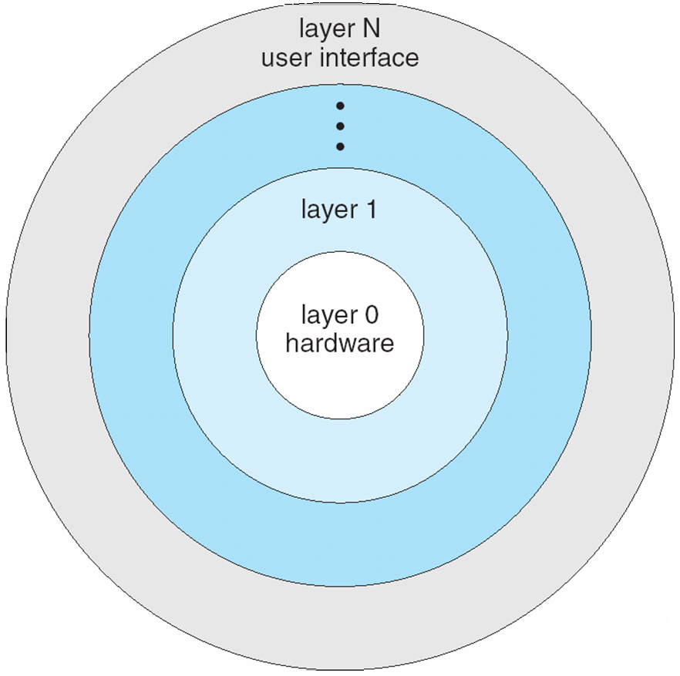
Layered Approach
The operating system is divided into a number of layers (levels), each built on top of lower layers. The bottom layer (layer 0), is the hardware; the highest (layer N) is the user interface.
With modularity, layers are selected such that each uses functions (operations) and services of only lower-level layers

Slide 54
Microkernel System Structure
Moves as much from the kernel into user space
Mach example of microkernel
Mac OS X kernel (Darwin) partly based on Mach
Communication takes place between user modules using message passing
Benefits:
Easier to extend a microkernel
Easier to port the operating system to new architectures
More reliable (less code is running in kernel mode)
More secure
Detriments:
Performance overhead of user space to kernel space communication

Slide 55
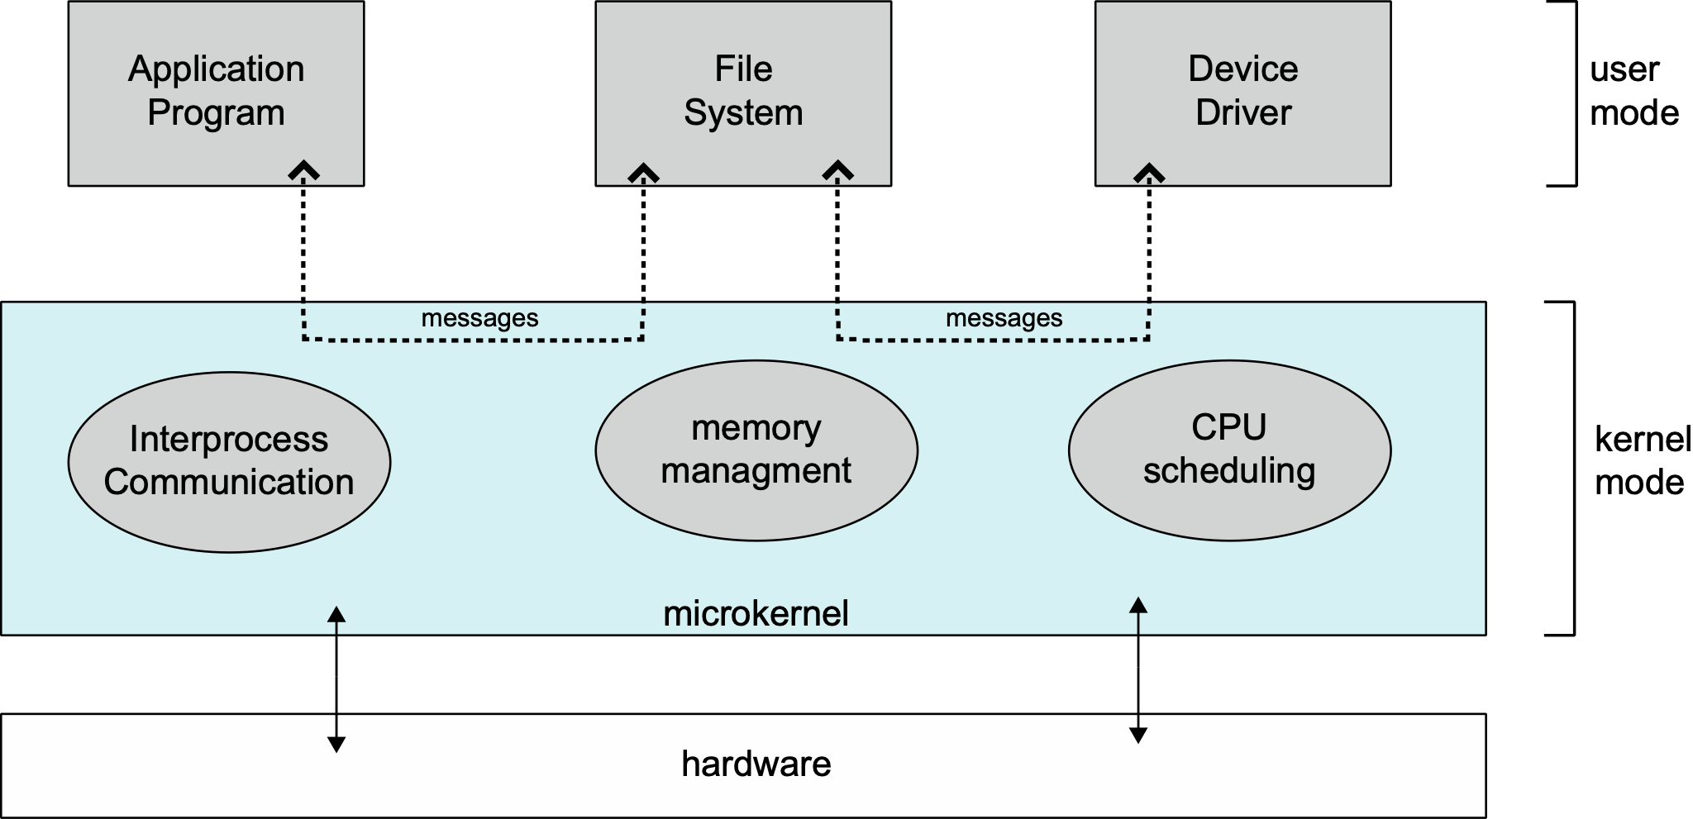
Microkernel System Structure

Slide 56
Modules
Many modern operating systems implement loadable kernel modules
Uses object-oriented approach
Each core component is separate
Each talks to the others over known interfaces
Each is loadable as needed within the kernel
Overall, similar to layers but with more flexible
Linux, Solaris, etc

Slide 57
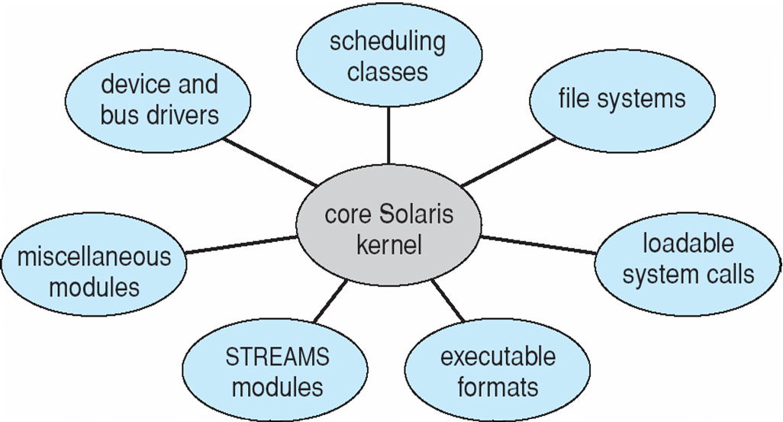
Solaris Modular Approach

Slide 58
Hybrid Systems
Most modern operating systems are actually not one pure model
Hybrid combines multiple approaches to address performance, security, usability needs
Linux and Solaris kernels in kernel address space, so monolithic, plus modular for dynamic loading of functionality
Windows mostly monolithic, plus microkernel for different subsystem personalities
Apple Mac OS X hybrid, layered, Aqua UI plus Cocoa programming environment
Below is kernel consisting of Mach microkernel and BSD Unix parts, plus I/O kit and dynamically loadable modules (called kernel extensions)

Slide 59
Processes

Slide 60
Process Concept
An operating system executes a variety of programs:
Batch system – jobs
Time-shared systems – user programs or tasks
Textbook uses the terms job and process almost interchangeably
Process – a program in execution; process execution must progress in sequential fashion
Multiple parts
The program code, also called text section
Current activity including program counter, processor registers
Stack containing temporary data
Function parameters, return addresses, local variables
Data section containing global variables
Heap containing memory dynamically allocated during run time

Slide 61
Process Concept (Cont.)
Program is passive entity stored on disk (executable file), process is active
Program becomes process when executable file loaded into memory
Execution of program started via GUI mouse clicks, command line entry of its name, etc
One program can be several processes
Consider multiple users executing the same program

Slide 62
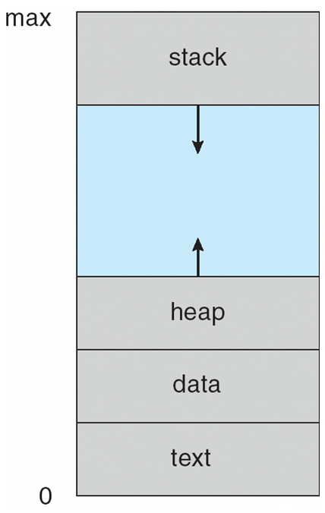
Process in Memory

Slide 63
Process State
As a process executes, it changes state
new: The process is being created
running: Instructions are being executed
waiting: The process is waiting for some event to occur
ready: The process is waiting to be assigned to a processor
terminated: The process has finished execution

Slide 64
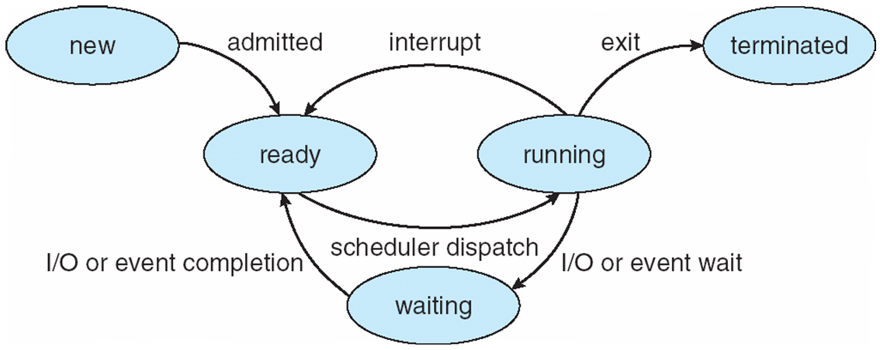
Diagram of Process State

Slide 65
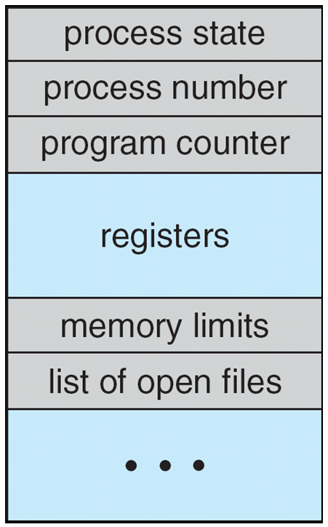
Process Control Block (PCB)
Information associated with each process
(also called task control block)
Process state – running, waiting, etc
Program counter – location of instruction to next execute
CPU registers – contents of all process-centric registers
CPU scheduling information- priorities, scheduling queue pointers
Memory-management information – memory allocated to the process
Accounting information – CPU used, clock time elapsed since start, time limits
I/O status information – I/O devices allocated to process, list of open files

Slide 66
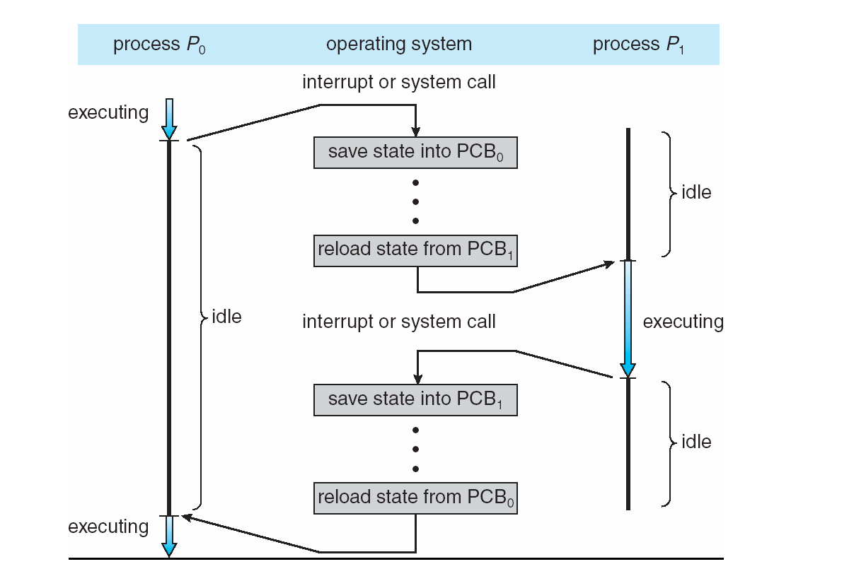
CPU Switch From Process to Process

Slide 67
Process Scheduling
Maximize CPU use, quickly switch processes onto CPU for time sharing
Process scheduler selects among available processes for next execution on CPU
Maintains scheduling queues of processes
Job queue – set of all processes in the system
Ready queue – set of all processes residing in main memory, ready and waiting to execute
Device queues – set of processes waiting for an I/O device
Processes migrate among the various queues

Slide 68
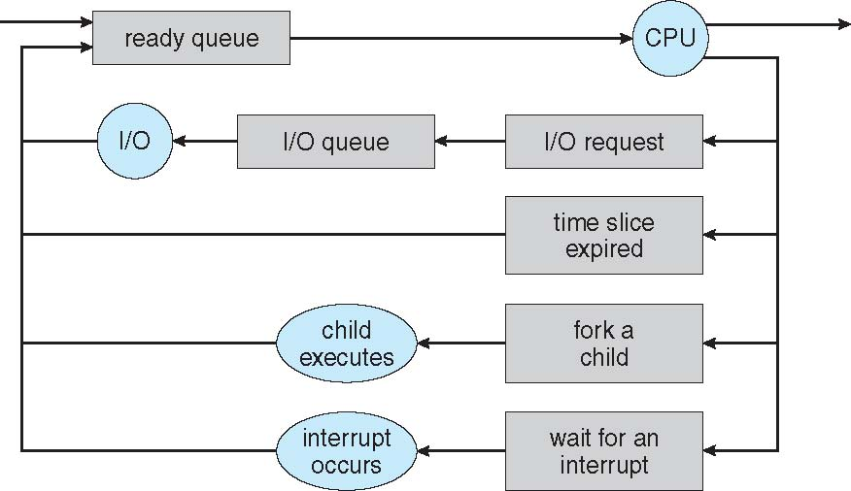
Representation of Process Scheduling
Queueing diagram represents queues, resources, flows

Slide 69
Schedulers
Short-term scheduler (or CPU scheduler) – selects which process should be executed next and allocates CPU
Sometimes the only scheduler in a system
Short-term scheduler is invoked frequently (milliseconds) ⇒ (must be fast)
Long-term scheduler (or job scheduler) – selects which processes should be brought into the ready queue
Long-term scheduler is invoked infrequently (seconds, minutes) ⇒ (may be slow)
The long-term scheduler controls the degree of multiprogramming
Processes can be described as either:
I/O-bound process – spends more time doing I/O than computations, many short CPU bursts
CPU-bound process – spends more time doing computations; few very long CPU bursts
Long-term scheduler strives for good process mix

Slide 70
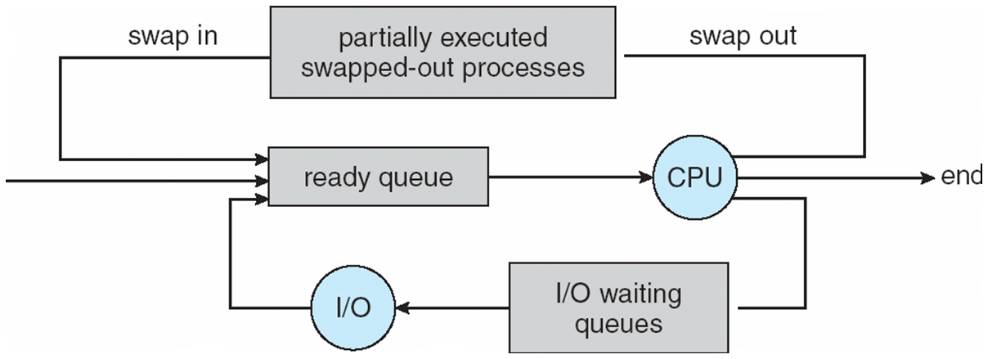
Addition of Medium Term Scheduling
Medium-term scheduler can be added if degree of multiple programming needs to decrease
Remove process from memory, store on disk, bring back in from disk to continue execution: swapping

Slide 71
Context Switch
When CPU switches to another process, the system must save the state of the old process and load the saved state for the new process via a context switch
Context of a process represented in the PCB
Context-switch time is overhead; the system does no useful work while switching
The more complex the OS and the PCB the longer the context switch
Time dependent on hardware support
Some hardware provides multiple sets of registers per CPU multiple contexts loaded at once

Slide 72
End of Process as a Concept

